Slide 1
Independent Study Final Presentation
Kelley School of Business
05/02/2023
INDIANA UNIVERSITY BLOOMINGTON

Slide 2
Objectives
Predict the event of opioid overdose (based on diagnosis codes) for patients based on their historical medical records – fixed data
Predict the event of opioid overdose for the subsequent 3 months window based on their previous 3 months medical records from the time of a patient’s first opioid prescription – fixed baseline 3-month data
In progress
Predict the event of opioid overdose for the subsequent 3 months window from every 3 months medical records from the time of a patient’s first opioid prescription – rolling window 3-month data

Slide 3
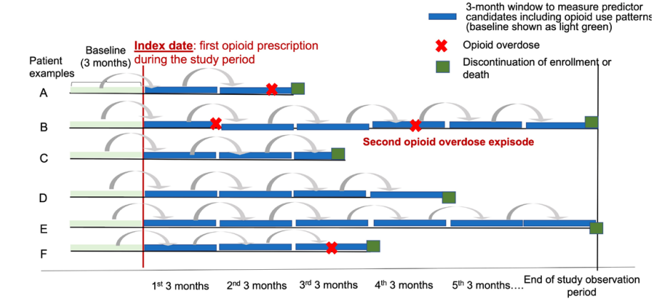
Objectives

Slide 4
Evaluation metrics for Classification models
Precision – we want to correctly identify an opioid harm patient
Recall – we want to correctly predict all opioid harm patients
Both the metrics are important for our use case, so we consider F-1 score, which is the weighted average of precision and recall
Confusion matrix – can get an understanding of number of correct and incorrect predictions
AUC-ROC – can get an understanding of model’s ability to distinguish between the classes
These are the metrics we used for evaluating the models

Slide 5
Approach
What is the dist of opioid harm across age groups, races and states?
Are numerical columns normally distributed?
Created new features for Diagnosis and Procedure codes based on incidence in data
Data Source ​
Schema: DODR (v81)
Feature Engineering
Exploratory Data Analysis
Data understanding
- Optum documentation
Report
Modeling and Evaluation
Feature Selection
Create a report to present the insights
Classification Models:
Logistic Regression
Random Forest
XGBoost
Evaluation Metrics
F1 score, AUCROC
Scaling features based on distribution
Converting categorical columns to numerical
Checking for correlation between features

Slide 6
Data description
Data – 2007 DODR (date of death with race) from all 53 states
Age – 12 to 90 years
Races – Asian, Black, Hispanic, White
Total no. of patients with at least one opioid in their prescriptions – ~2.9M (fixed data pred)
Total no. of patients with opioid harm – ~37K
Total no. of patients with non-opioid harm - 40K (randomly sampled based on above number)
Total no. of patients with at least one opioid in their prescriptions – ~2.9M (3 month window pred)
Total no. of patients with non - opioid harm – ~67K (98%)
Total no. of patients with opioid harm - ~1K (2%)

Slide 7
Data exclusions
Patients with age < 10 years
Patients with cancer diagnosis (based on procedure codes)
Only for 3-month window prediction:
Patients with less than 3 month look back period from the date of first opioid prescription (based on plan eligibility dates)
Patients not enrolled for at least 3 months from the date of first opioid prescription (based on plan eligibility dates)

Slide 8
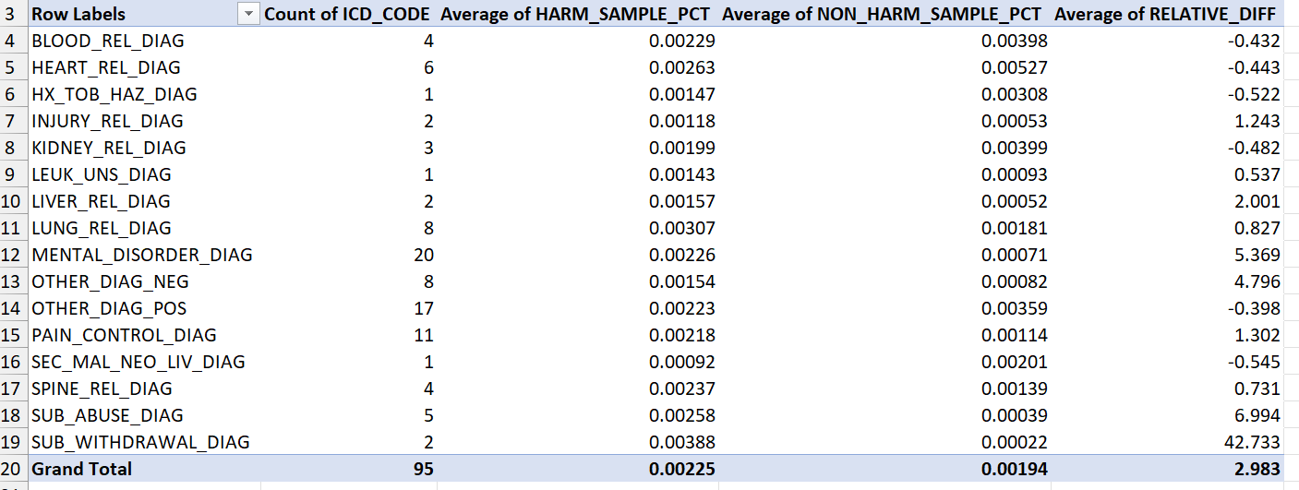
Feature engineering
Checked for incidence difference for DIAG codes in opioid harm and all non-opioid harm patient's data for top ‘200’ most frequent codes (relative differential threshold = 0.3).

Slide 9
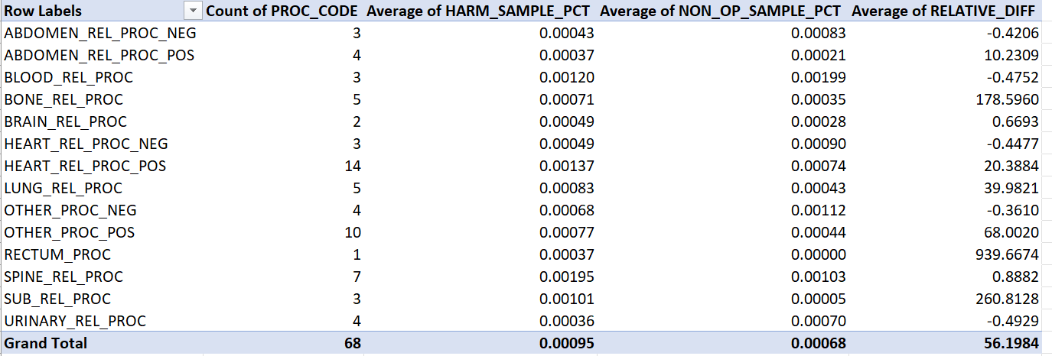
Feature engineering
Checked for incidence difference for PROC codes in opioid harm and all non-opioid harm patient’s data for top ‘200’ most frequent codes (relative differential threshold = 0.3).

Slide 10
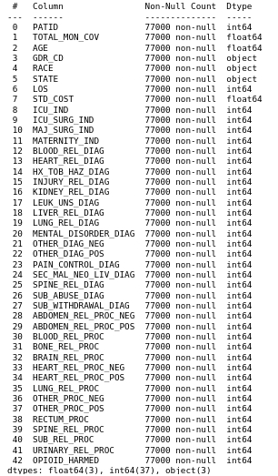
Feature engineering
Created categories for different DIAG/PROC codes and created a new column with 1/0 wherever codes belonging to that category are present

Slide 11
Data Preparation
Identified patients with at least one opioid prescription (using NDC codes)
Filtered for the above patients in Inpatient data (data – Confinement, col - PATID)
Within above patients, filtered out for cancer patients using procedure codes (data – Confinement, cols – PROC, PATID)
Finally, filtered for patients with opioid diagnosis using diagnosis codes (data – Confinement, cols – DIAG)
Sampled for patients from rest of the non-opioid harm patients based on number of opioid harm patients

Slide 12
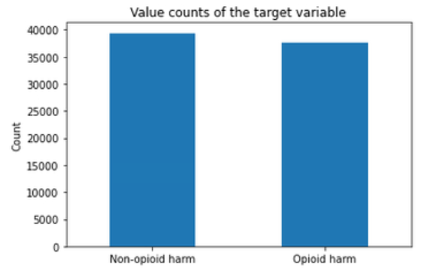
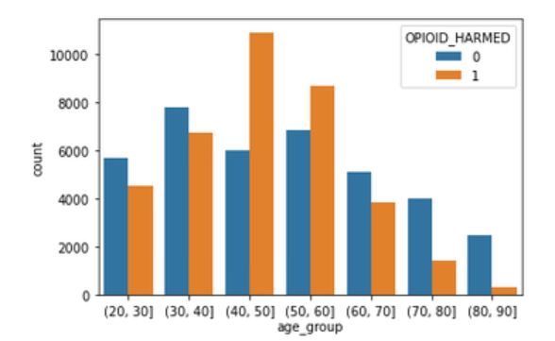
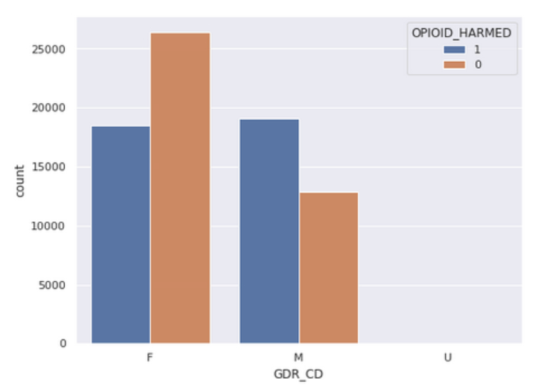
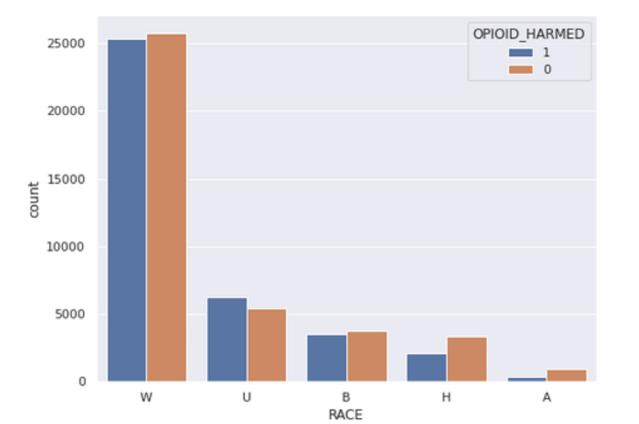
Exploratory data analysis

Slide 13
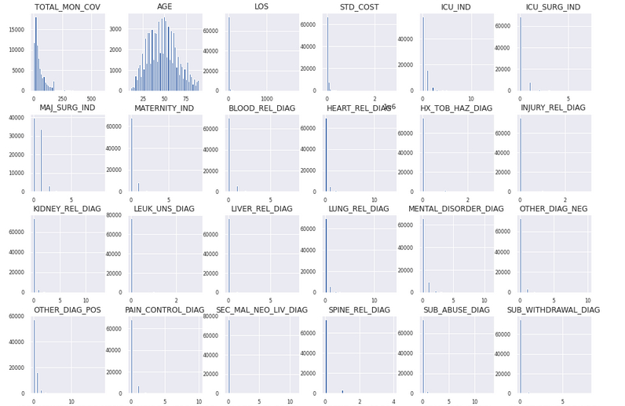
Exploratory data analysis

Slide 14
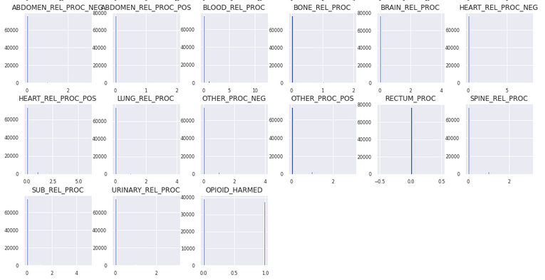
Exploratory data analysis
None of the columns show normal distribution except Age. Scaled features based on their distributions

Slide 15
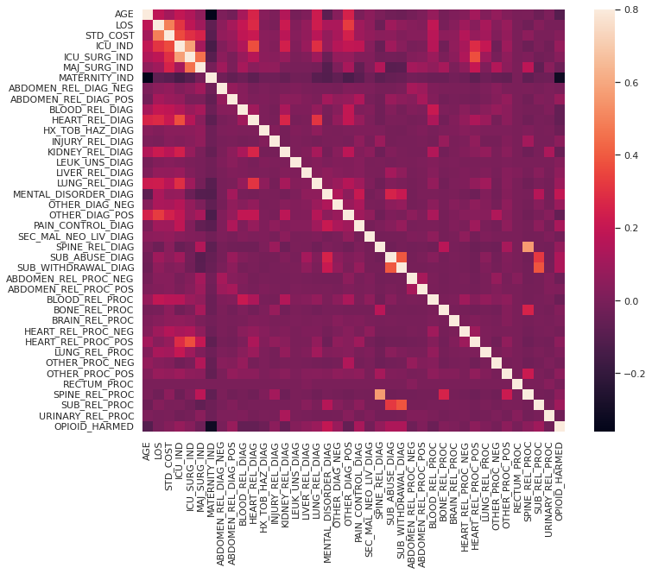
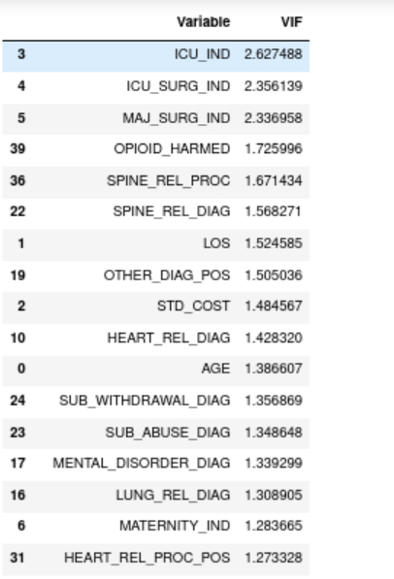
Did not observe high correlation between features and also high VIF

Slide 16
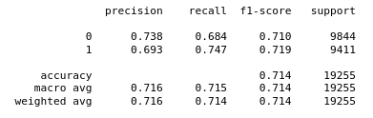
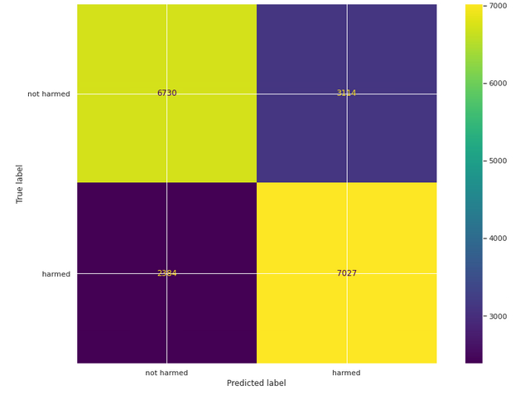
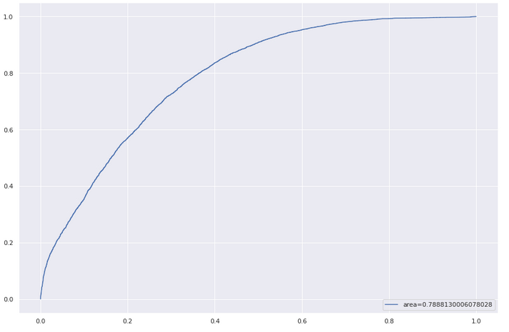
Model results - LR
Best parameters from grid search: l1_ratio=0.25, penalty='l1', solver='liblinear'

Slide 17
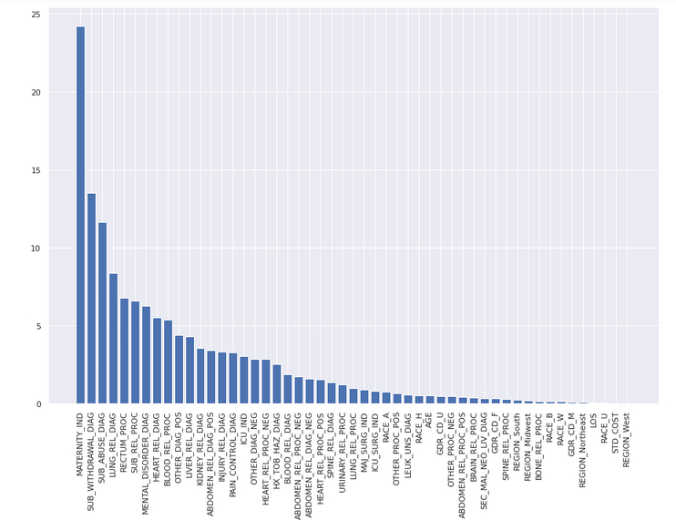
Model results - LR

Slide 18
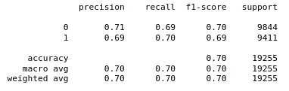
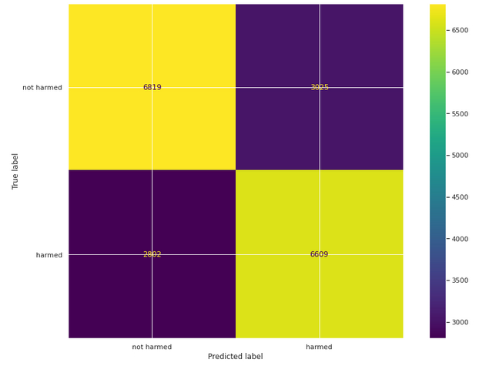
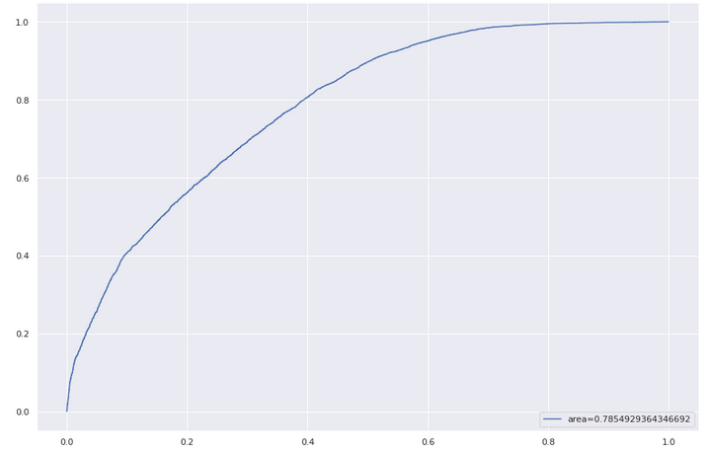
Model results - RF
Best parameters from grid search: max_depth=6, max_features=8, min_samples_leaf=6,n_estimators=120

Slide 19
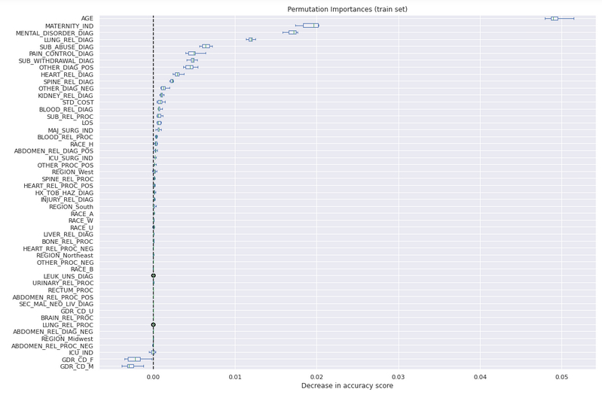
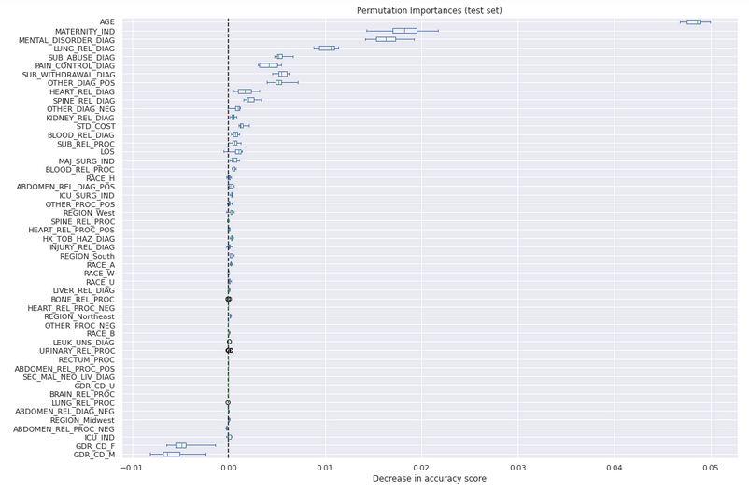
Model results - RF

Slide 20
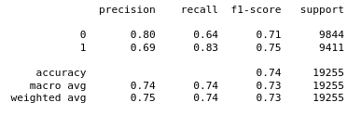
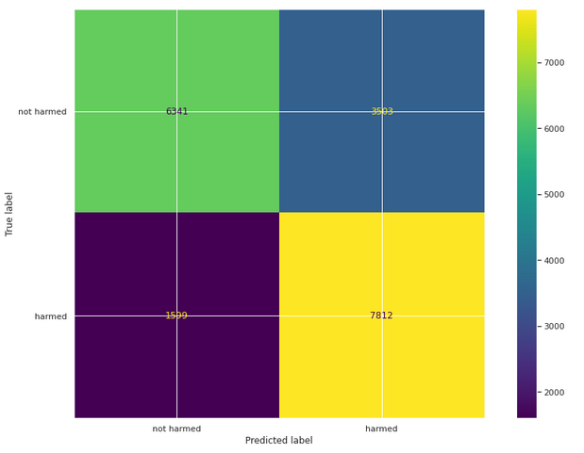
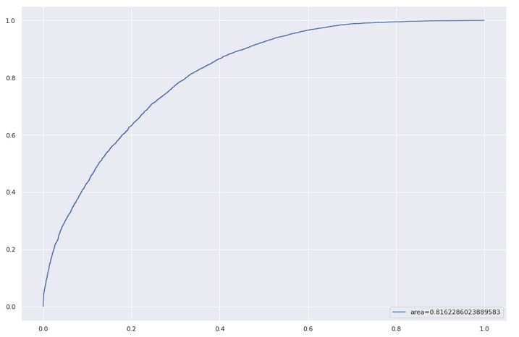
Model results - XGB
Best parameters from grid search: 'gamma': 1.05, 'learning_rate': 0.85, 'max_depth': 3, 'reg_lambda': 0.9, 'scale_pos_weight': 1.2

Slide 21
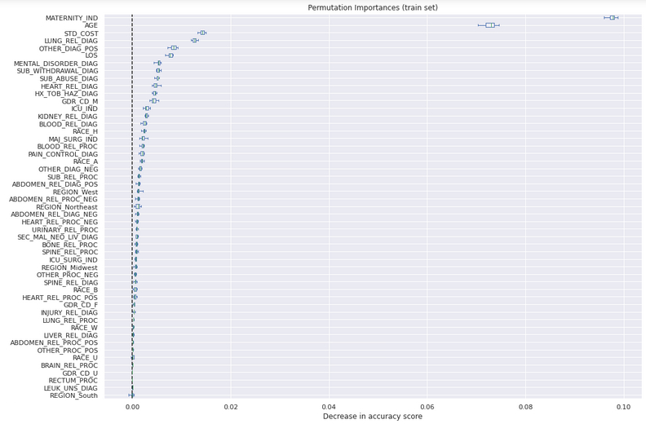
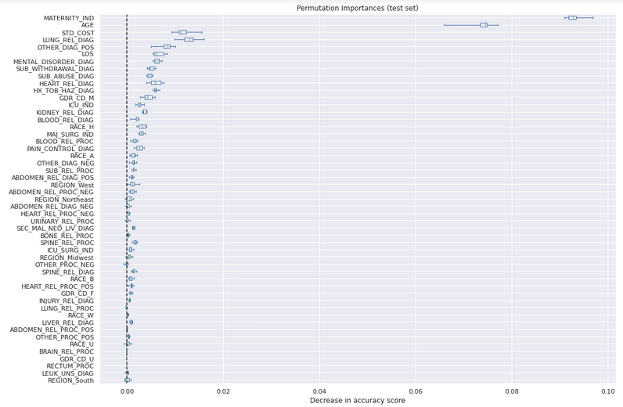
Model results - XGB

Slide 22
Model results comparison
Model | Accuracy | F1 score | AUCROC
Logistic Regression | 71% | 72% | 0.78
Random Forest | 70% | 70% | 0.78
XGBoost | 74% | 75% | 0.81
Logistic Regression | Random Forest | XGBoost
MATERNITY_IND | AGE | MATERNITY_IND
SUB_WITHDRAWAL_DIAG | MATERNITY_IND | AGE
SUB_ABUSE_DIAG | MENTAL_DISORDER_DIAG | STD_COST
LUNG_REL_DIAG | LUNG_REL_DIAG | LUNG_REL_DIAG
SUB_REL_PROC | SUB_ABUSE_DIAG | OTHER_DIAG_POS
Top 5 features – based on feature importance

Slide 23
Data Preparation
Identified patients with at least one opioid prescription (using NDC codes)
Filtered for the above patients in Inpatient data (data – Confinement, col - PATID)
Within above patients, filtered out for cancer patients using procedure codes (data – Confinement, cols – PROC, PATID)
Finally, filtered for patients with opioid diagnosis using diagnosis codes (data – Confinement, cols – DIAG)
Sampled for patients from rest of the non-opioid harm patients based on number of opioid harm patients

Slide 24
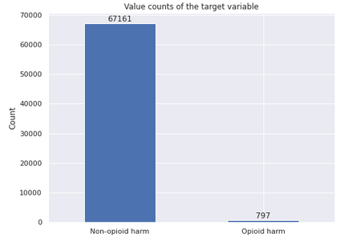
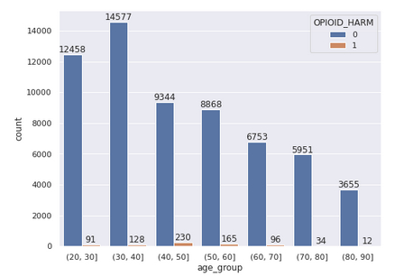
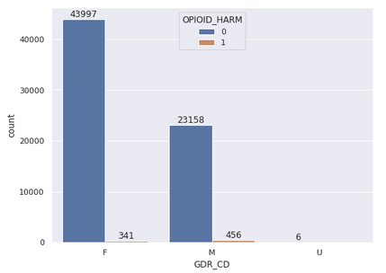
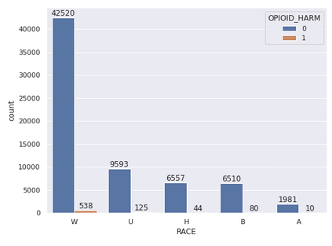
Exploratory data analysis

Slide 25
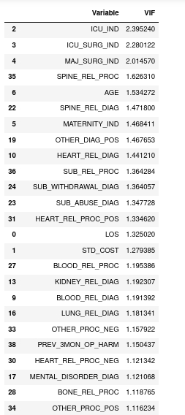
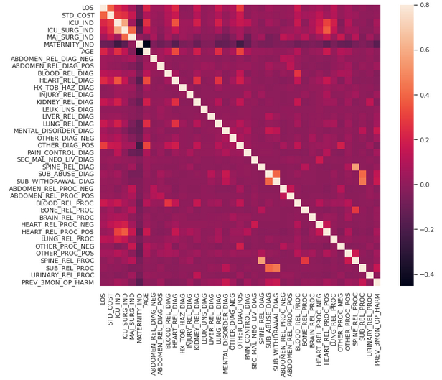
Did not observe high correlation between features and also high VIF

Slide 26
Dealing with data imbalance
We have severe class imbalance in data with only 2% of opioid harm patients. Few ways I’ve explored to deal with this issue:
Changing probability threshold – checked for different thresholds for optimal value by looking at AUC-ROC and precision-recall curves
Cost sensitive algorithms – assigning weights based on class distribution for coefficient update
Oversampling & Under sampling
Synthetic sample generation – SMOTE
Got best results using smote sampled data compared to other methods

Slide 27
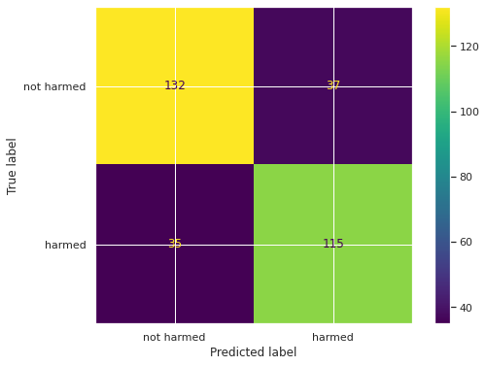
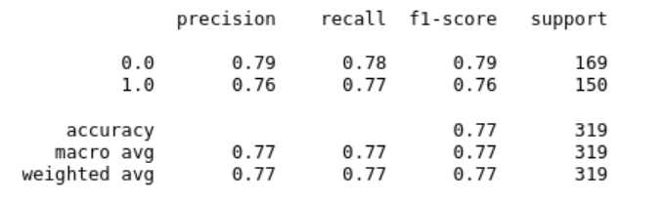
Model results - LR
Best parameters from grid search: l1_ratio=0.25, penalty='l1', solver='liblinear'

Slide 28
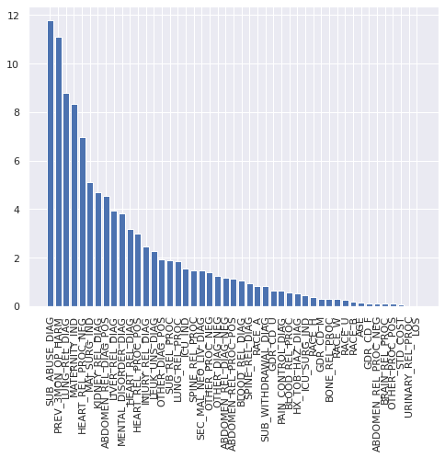
Model results - LR

Slide 29
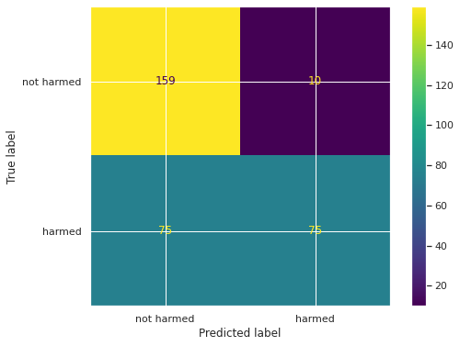
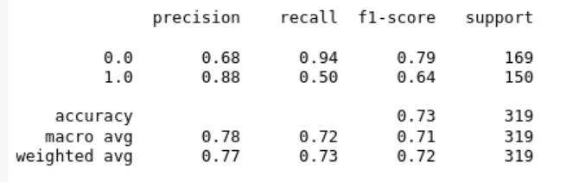
Model results - RF
Best parameters from grid search: max_depth=7, max_features='log2',n_estimators=500,

Slide 30
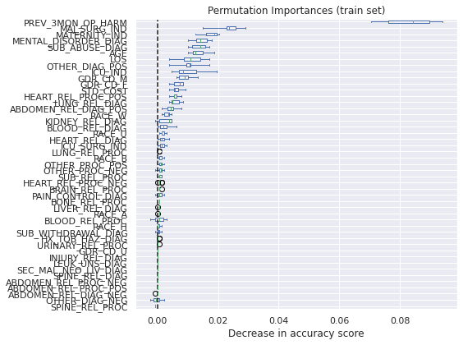
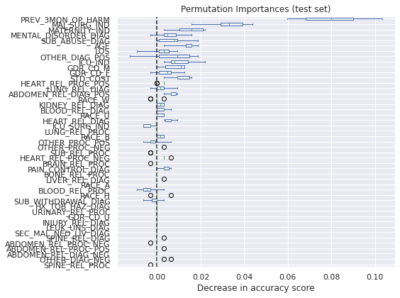
Model results - RF

Slide 31
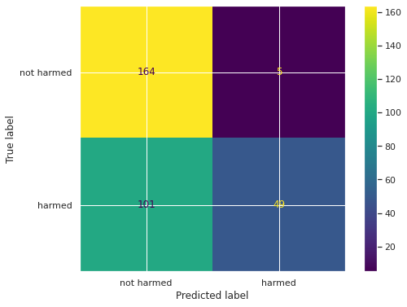
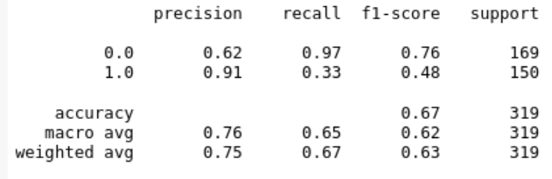
Model results - XGB
Best parameters from grid search: gamma = 1.05, learning_rate = 0.85, max_depth = 3, reg_lambda= 1, scale_pos_weight =1

Slide 32
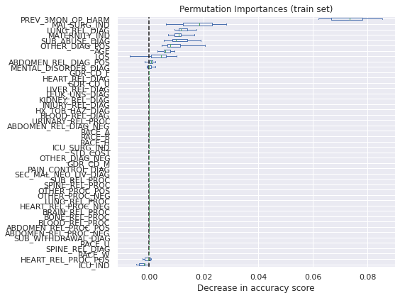
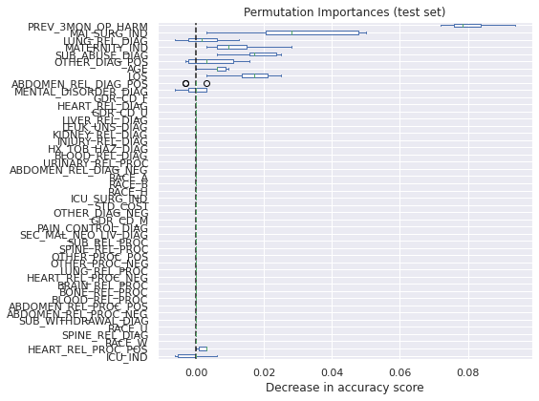
Model results - XGB

Slide 33
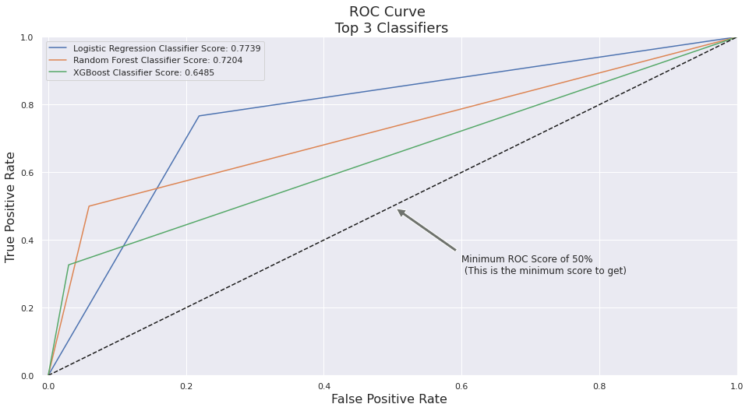
Model results comparison

Slide 34
Model results comparison
Model | Accuracy | F1 score | AUCROC
Logistic Regression | 77% | 76% | 0.77
Random Forest | 73% | 64% | 0.72
XGBoost | 67% | 48% | 0.64
Logistic Regression | Random Forest | XGBoost
SUB_ABUSE_DIAG | PREV_3MON_OP_HARM | PREV_3MON_OP_HARM
PREV_3MON_OP_HARM | MAJ_SURG_IND | MAJ_SURG_IND
LUNG_REL_DIAG | MATERNITY_IND | LUNG_REL_DIAG
MATERNITY_IND | MENTAL_DISORDER_DIAG | MATERNITY_IND
HEART_REL_PROC_NEG | SUB_ABUSE_DIAG | SUB_ABUSE_DIAG
Top 5 features – based on feature importance

Slide 35
Work in progress and future steps
Data preprocessing, feature engineering, feature elimination and model fine tuning for better results
Rolling window creation for every 3-months
Try different neural network architectures for classification

Slide 36
APPENDIX

Slide 37
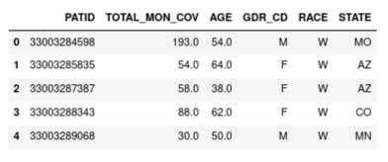
Data preprocessing
Member enrollment data
Columns created – ‘Total months of coverage’, ‘Age’
Columns removed - 'PAT_PLANID', 'ASO', 'BUS', 'CDHP', 'ELIGEFF', 'ELIGEND’, 'FAMILY_ID', 'GROUP_NBR', 'HEALTH_EXCH', 'LIS_DUAL’, 'PRODUCT', 'YRDOB'

Slide 38
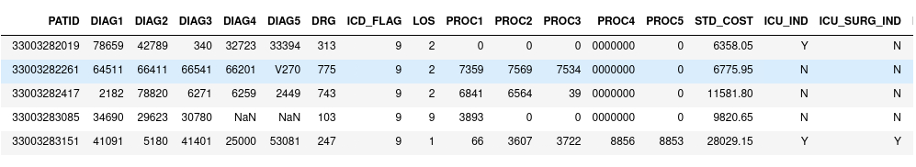
Data preprocessing
Confinement Inpatient data
Columns removed - 'PAT_PLANID', 'ADMIT_DATE', 'CHARGE', 'COINS', 'CONF_ID’, 'COPAY', 'DEDUCT', 'DISCH_DATE', 'DSTATUS', 'IPSTATUS', 'POS', 'PROV', 'STD_COST_YR', 'TOS_CD', 'NEWBORN_IND', 'TOS_EXT’
Created a DRG description mapping column from lookup tables
Replaced null (‘ ’) values in DIAG, PROC, DRG columns with ‘0000’ for ‘UNKNOWN CODE’

Slide 39
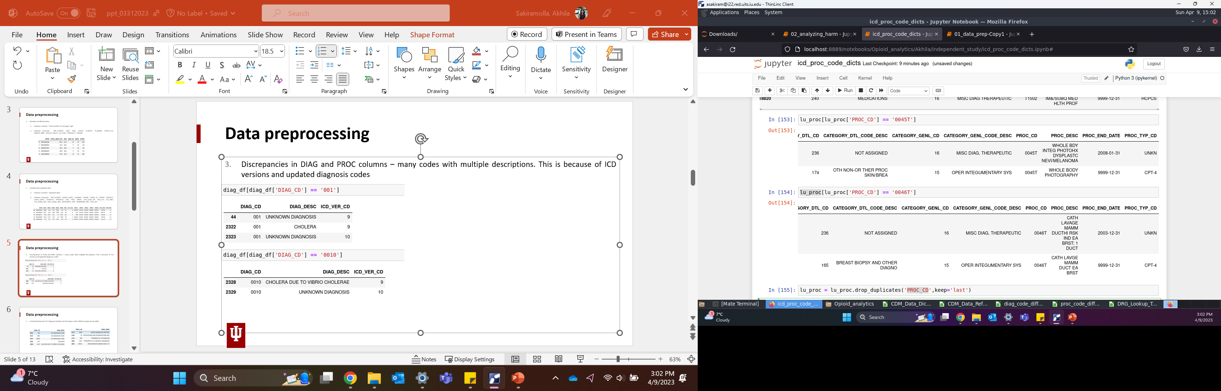
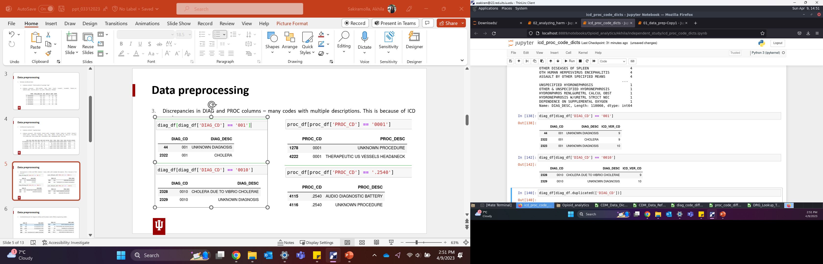
Data preprocessing
Duplicates in DIAG and PROC columns – many codes with multiple descriptions. This is because of ICD versions and updated diagnosis codes

Slide 40
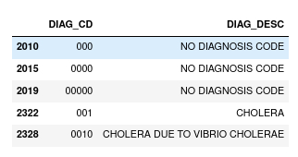
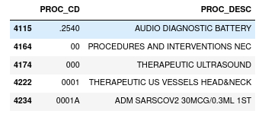
Data preprocessing
Created dictionaries for Diagnosis (DIAG) and Procedure codes (PROC) using look up tables

Slide 41


Slide 42

Model results comparison

